Slide 1
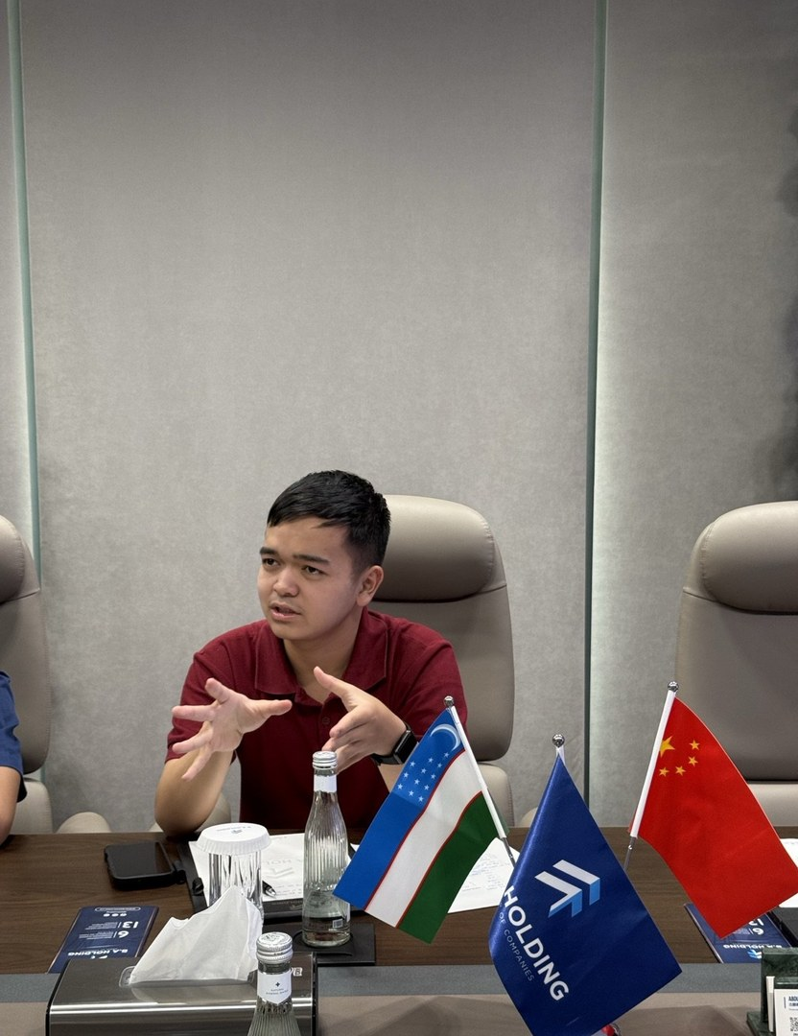
COMPREHENSIVE EXCELLENCE AWARD
DESIGNING
BRIDGES
between cultures, disciplines and people
Rafi Adifa Maulana
Zijing College · Class 51 · Urban Planning
Notes:
[~13 s] Good afternoon, teachers. I'm Rafi Adifa Maulana, from Zijing Class 51, studying Urban Planning. One idea connects everything I did this year: designing bridges, between cultures, between disciplines, and between people.

Slide 2
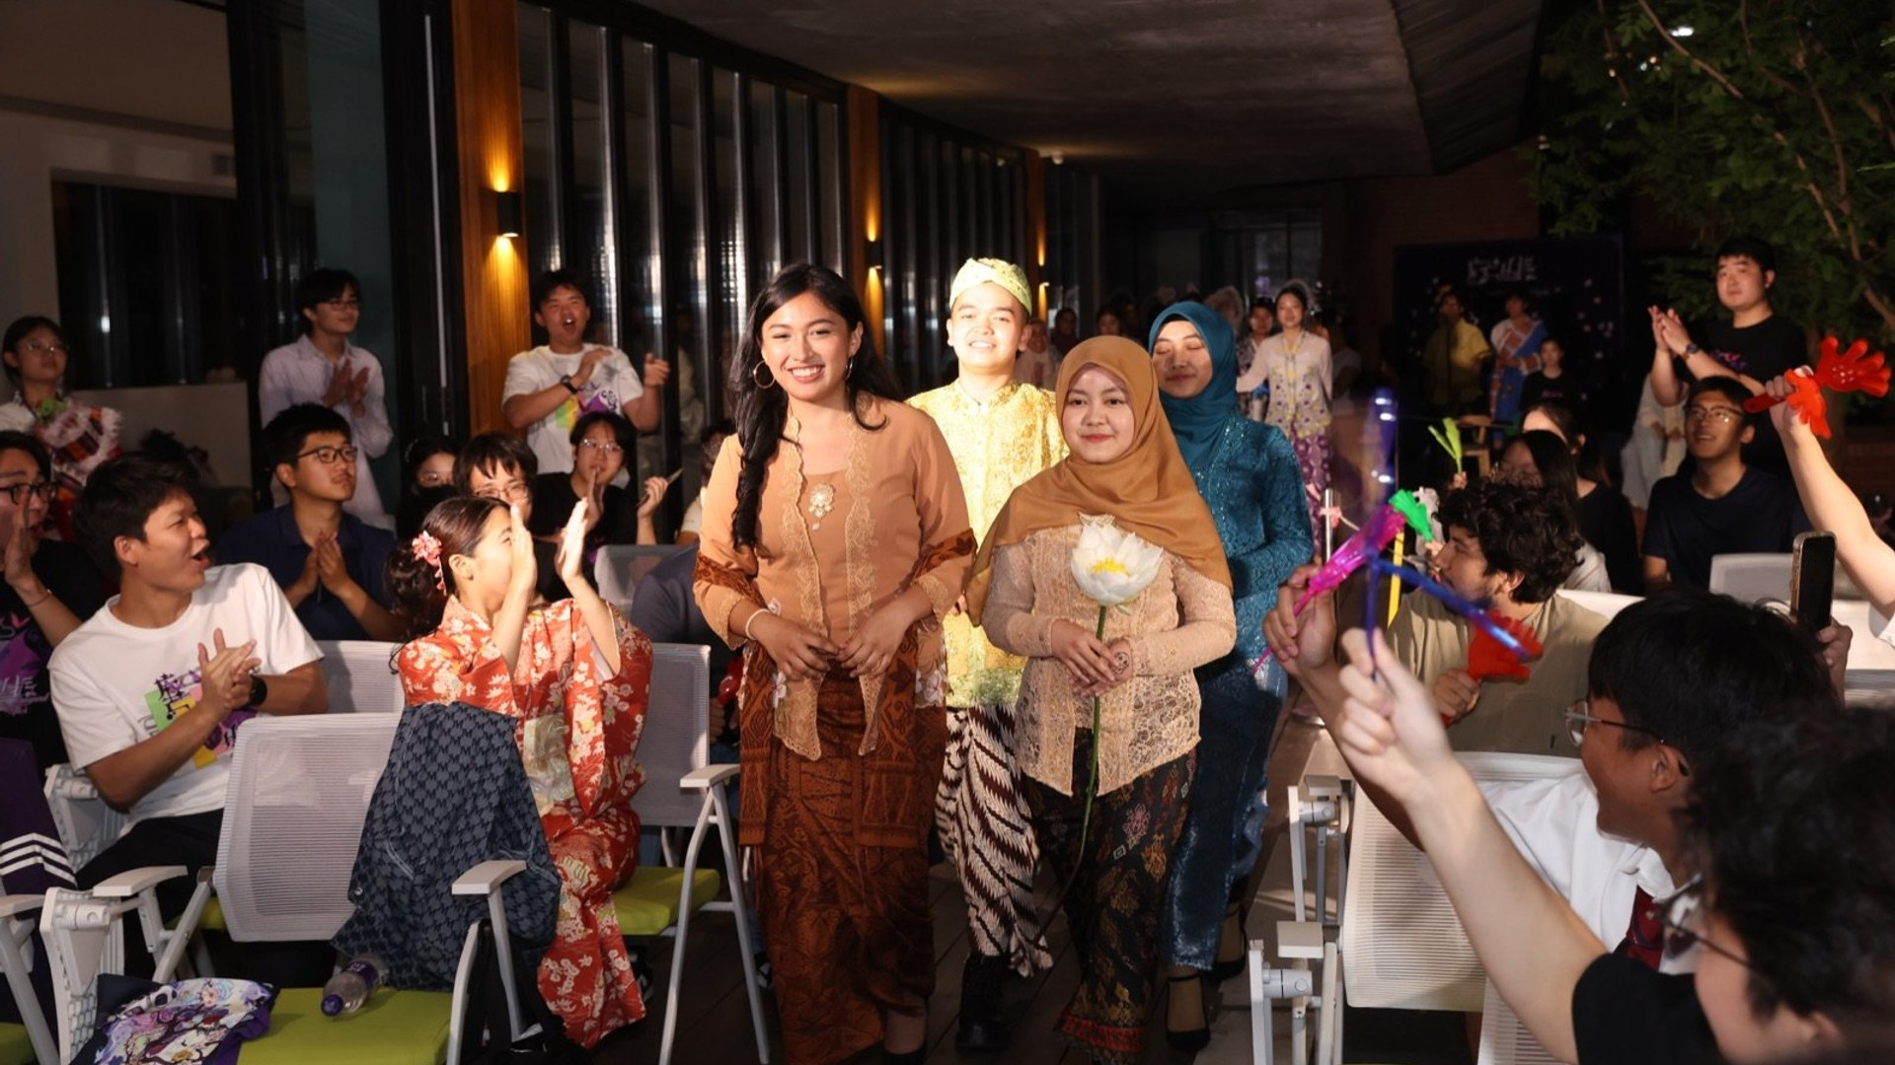

01 · ROOTS
From Kampung Naga to Tsinghua
Sundanese, from West Java, Indonesia. Now studying Urban Planning at Zijing College.
Sundanese dress at the Zijing multicultural fashion show
Notes:
[~25 s] I'm Sundanese, from West Java, and my family comes from Kampung Naga, a traditional village that still lives the way its ancestors built it. That's where I learned that buildings carry culture, and it's why I came to Tsinghua to study planning. At Zijing I keep bringing cultures into the same room, like wearing Sundanese dress in our multicultural fashion show.

Slide 3
02 · LEARN
A solid academic base
3.735
19th
5th
0
GPA out of 4.0
in Zijing College
in Class 51
failed courses
Notes:
[~10 s] First, the base. My GPA is 3.735 out of 4.0. I'm 19th in Zijing College and 5th in Class 51, with no failed courses.

Slide 4
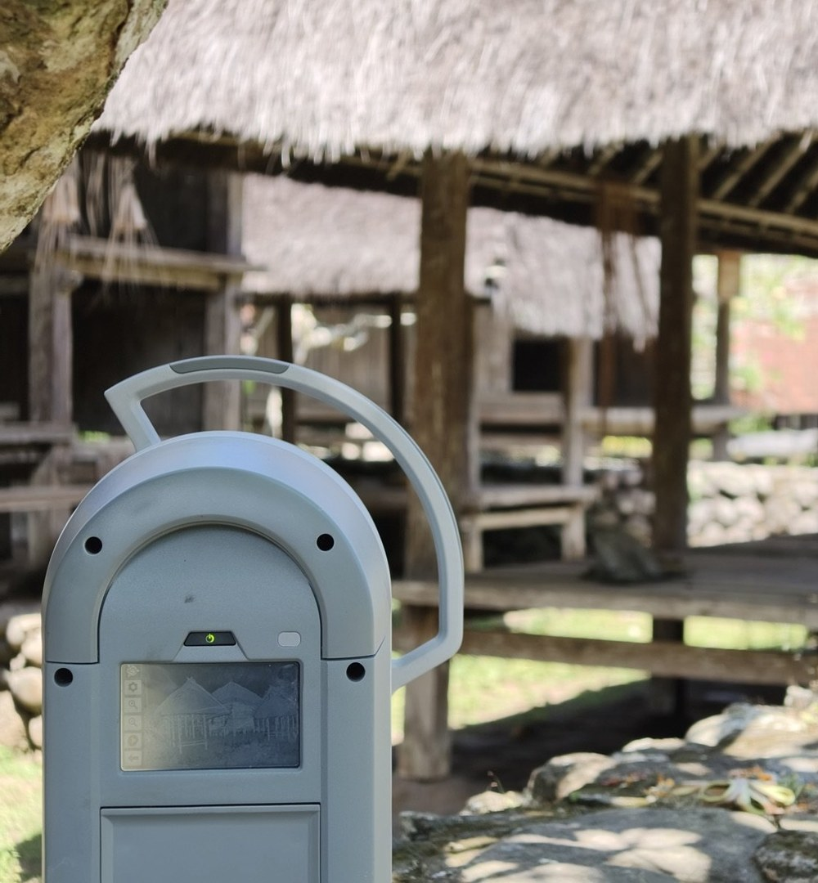
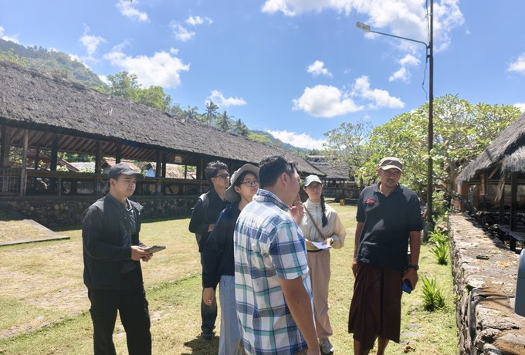
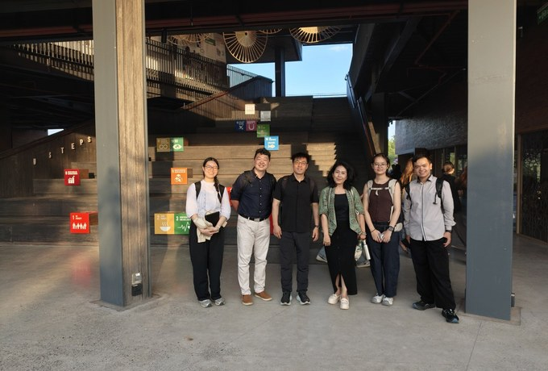
03 · BUILD
Scanning heritage, then sharing it
Our SRT team 3D-scanned Tenganan's historic buildings to document and help preserve them.
On site in Tenganan village
Co-organizer, international conference
Also built: PHYLING balsa structure · Qingfen canteen seating-map prototype
SRT · 3D scanner in action, Tenganan, Bali
Notes:
[~29 s] Second, building. With my SRT team in Tenganan, Bali, we 3D-scanned the village's historic buildings to document and help preserve them. I handled much of the communication and logistics on site, and I helped organize the international conference where we shared the work. In studio I keep the same habit, design it and then build it, from an earthquake-resilient balsa structure to a live seating-map prototype for the Qingfen canteen.

Slide 5

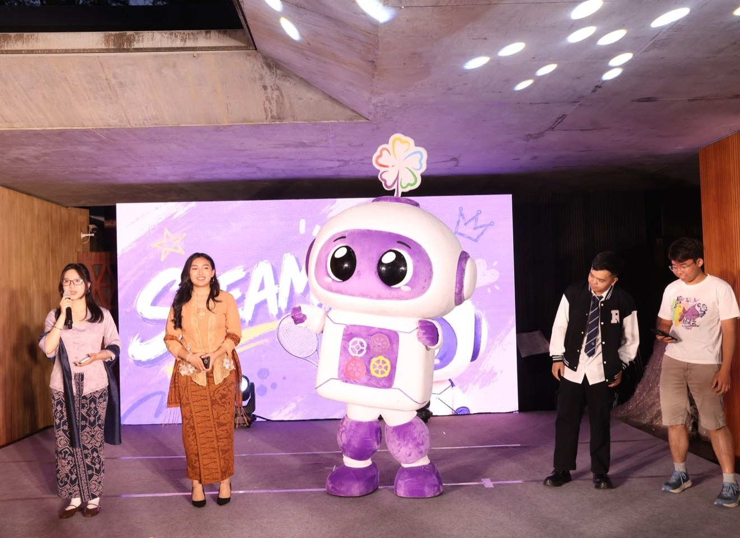
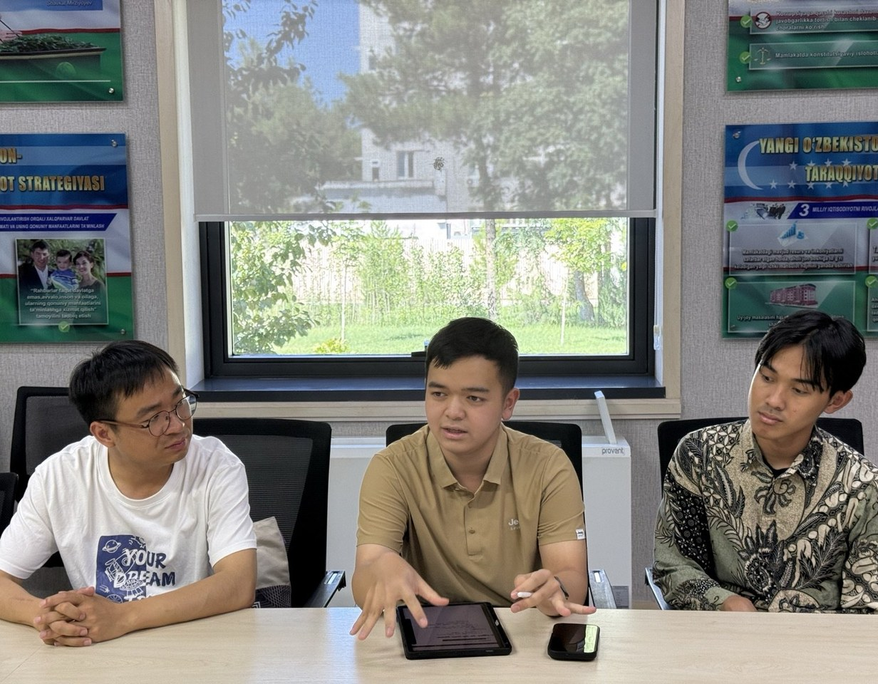
04 · SERVE
Designing for Zijing
Student Association · Sci-Tech Admin & Design team, 2025–present
First point of contact for 14 Garuda scholars
Uzbekistan deep dive: main designer, WeChat series + magazine
Steamy, Zijing's mascot · 1st place design
Practice: Uzbekistan · Guangzhou (team A) · Tenganan
Notes:
[~30 s] Third, serving. Since 2025 I've been on the Student Association's Science and Technology Administration and Design team. I'm the main designer of Zijing's Uzbekistan deep dive, the WeChat series and now the magazine, and my Steamy design won first place as Zijing's mascot. I joined three practice programs: Guangzhou, where our team earned an A, Uzbekistan, and Tenganan. And for our fourteen Garuda scholars, I'm the person newer students come to first.

Slide 6
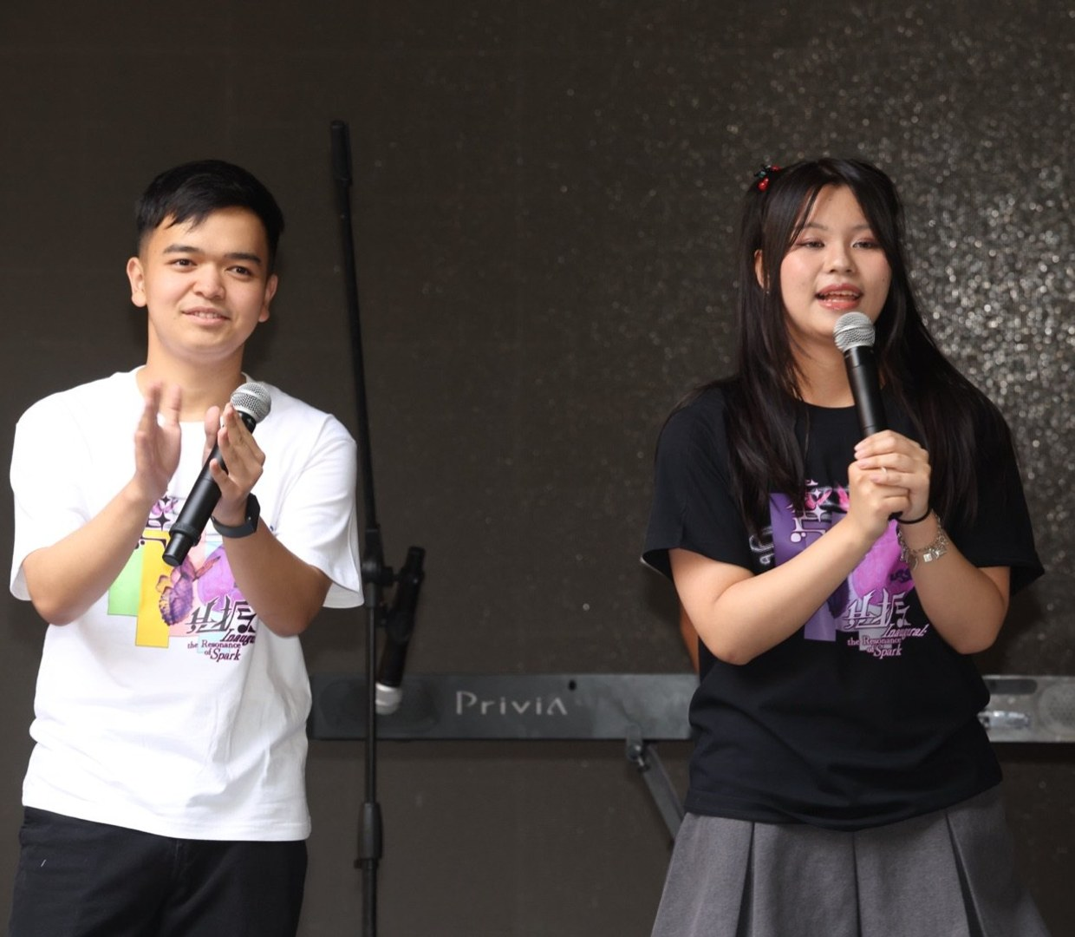

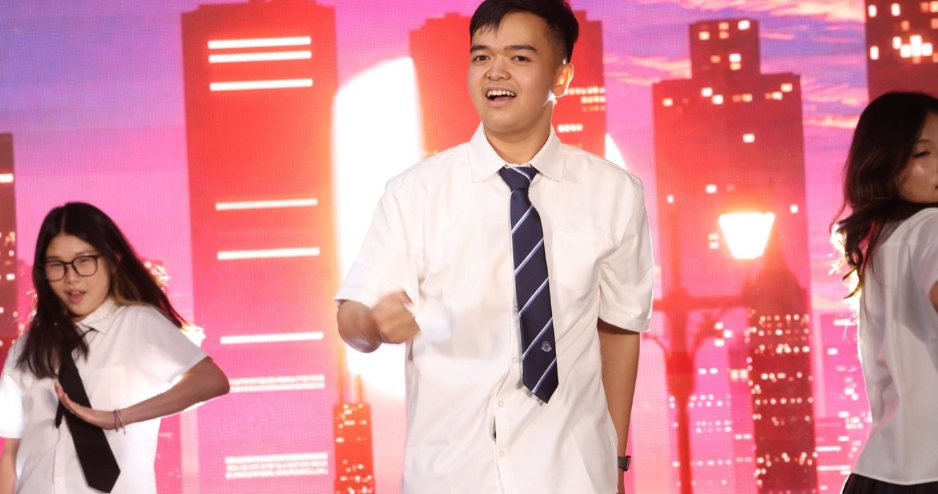
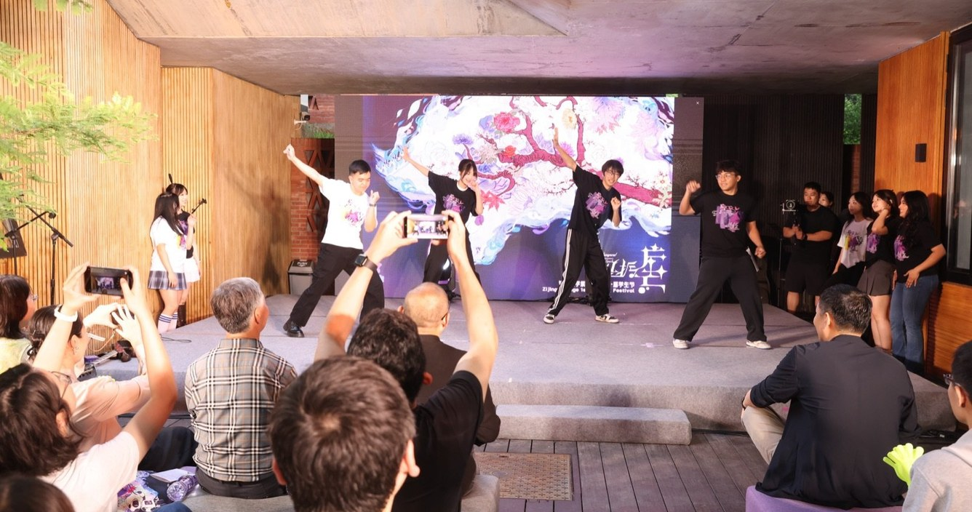
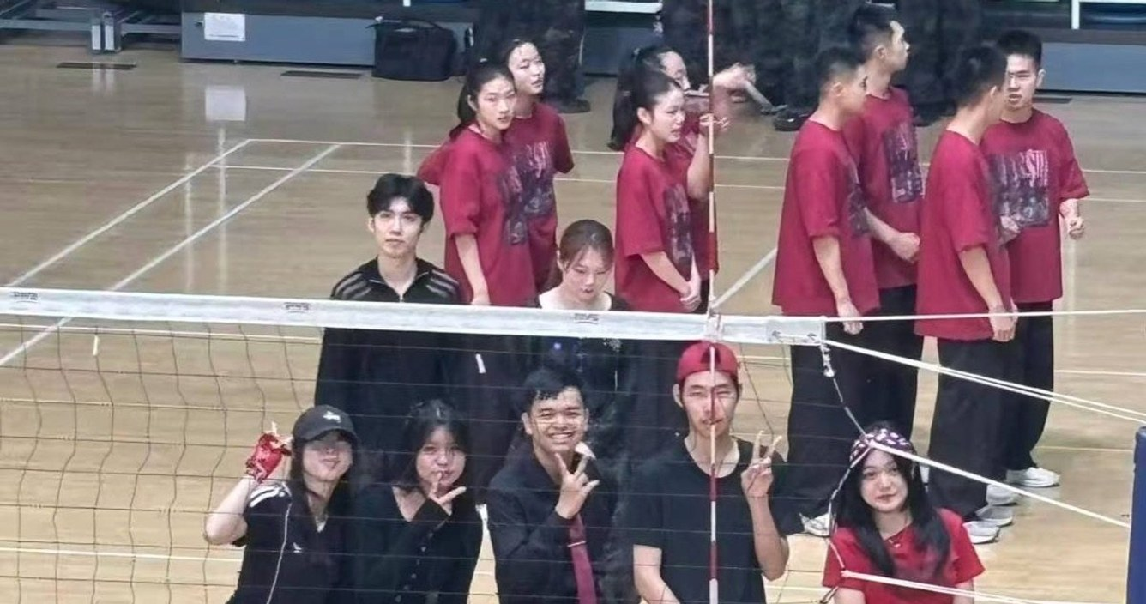
C:RUSH K-pop set · coordinator
Chinese-song dance · Student Festival
05 · PERFORM
Zijing's first theme song: “One”
Ma Cup cheer · 5th place + Sportsmanship Award
Lyrics & lead vocals · Student Festival, 23 May 2026
Notes:
[~19 s] Fourth, performing. I wrote the lyrics and sang lead on "One", Zijing's first theme song, at the Student Festival in May. I danced in two festival performances, coordinated our K-pop set with C:RUSH, and our Ma Cup cheer team placed fifth with the Sportsmanship Award.

Slide 7
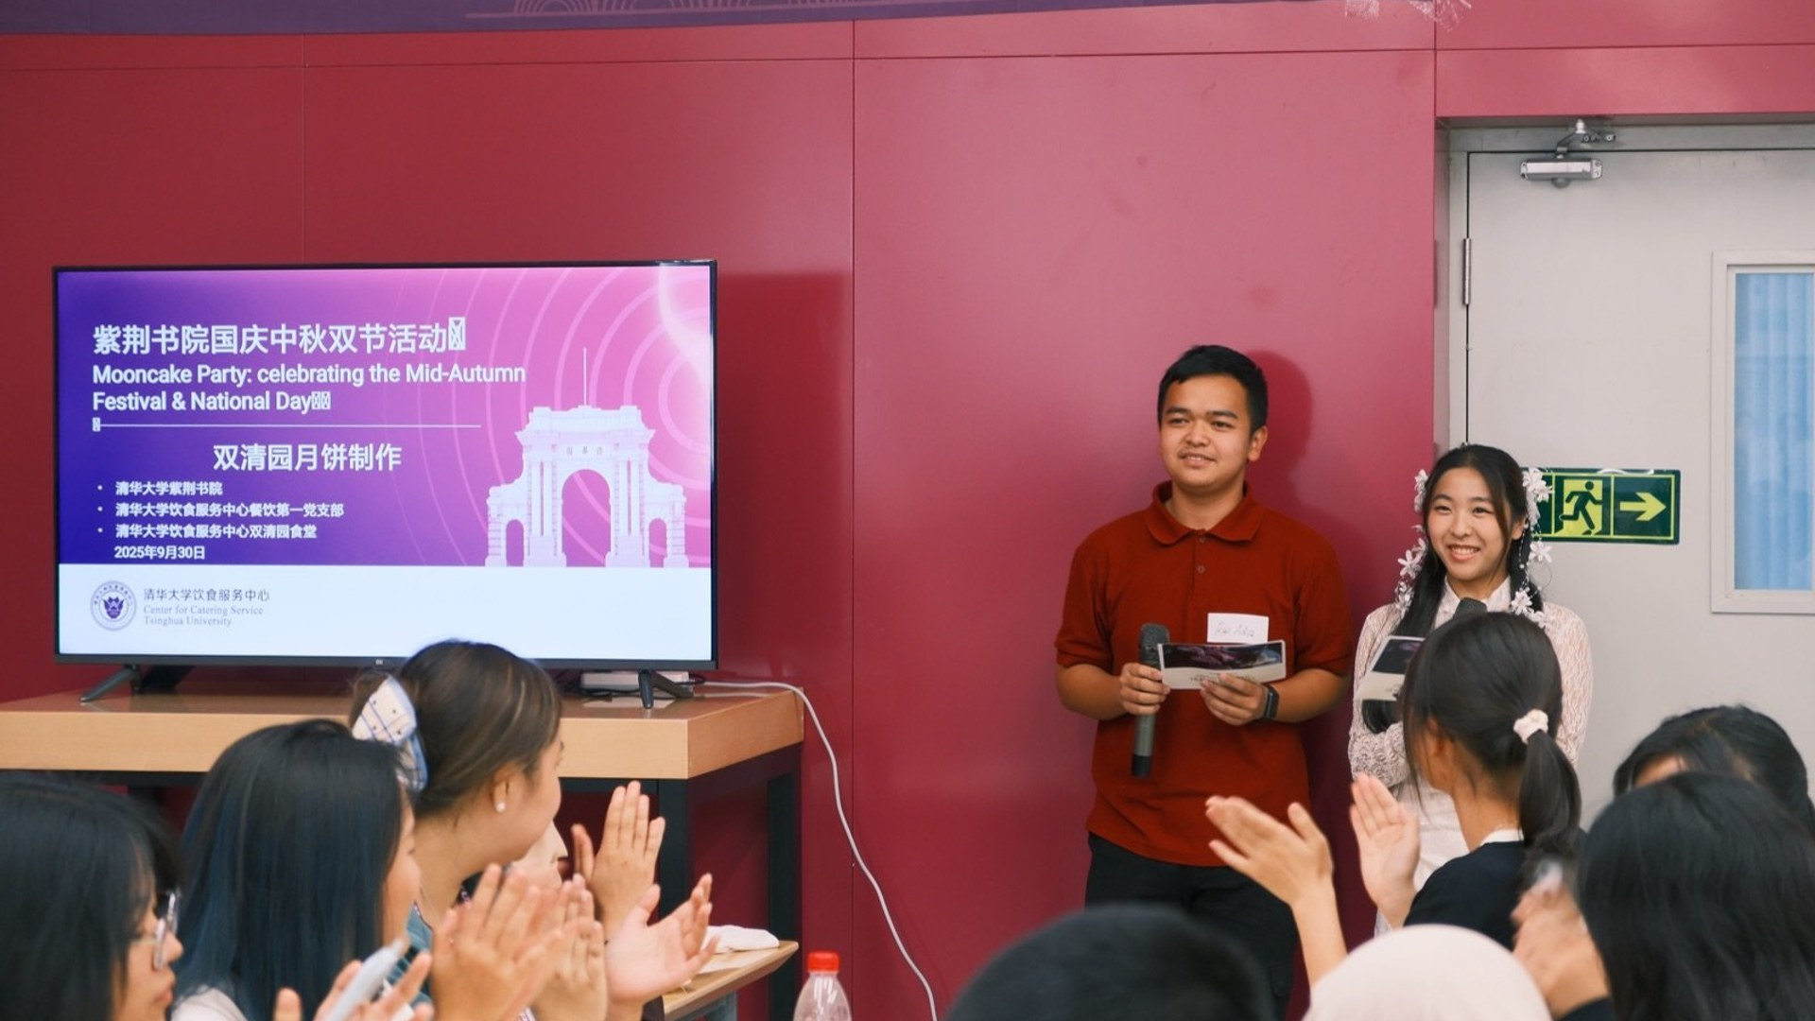

06 · NEXT
Keep building bridges for Zijing
Publish the Uzbekistan deep-dive magazine
Keep guiding new Garuda scholars
Keep bringing Zijing to the stage
Terima kasih · Thank you
Notes:
[~14 s] Next, I want to keep building these bridges: publish the Uzbekistan magazine, keep guiding new Garuda scholars, and keep bringing Zijing to the stage. Terima kasih, thank you. I'm happy to take your questions.
--- Q&A PREP (2 minutes; answer in 20-30 s each, then stop) ---
Q: How do you balance all of this with your studies?
Point to the numbers: 3.735 GPA, 19th in college, 5th in class, no failed courses. Then one concrete habit you really use (e.g. how you plan your week).
Q: What exactly was YOUR role in the Tenganan SRT?
On-the-ground communication and logistics (you speak Indonesian, so you were the bridge to the village), plus the scanning work itself. Then the conference, where the work was shared.
Q: You're an international student. How do you contribute to Zijing as a community, not just yourself?
Garuda group: the person 14 scholars come to first. Design work the whole college uses: Steamy, the Uzbekistan series. "One" was written for Zijing.
Q: Which achievement are you proudest of, and why?
Pick one and tell it as a short story (e.g. writing "One": why, what the lyrics say, what performing it felt like).
Q: What will you improve next year?
Be honest and specific: one area to grow (e.g. Chinese level, research depth) and a concrete step.

